Slide 1
Implementing quantum multi-collision algorithm on Qiskit

Slide 2
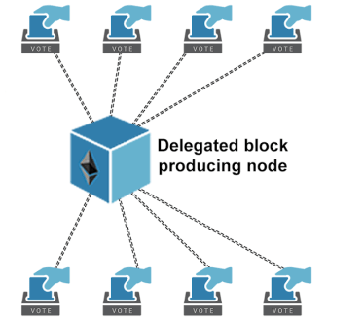
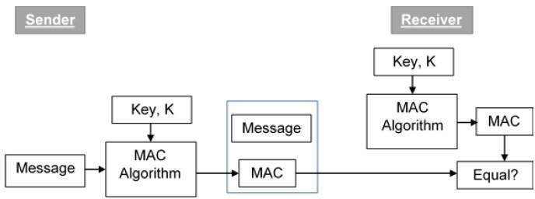
Problems
Notes:
What problems?
One of the encryption schemes for EVM is using Hash fucnc.
Similarily, MAC(message authentication code) algo. in networking using Hash func.
>>> QC can find the Hash with better complexity than CC.
Want to do:
Attack algorithm on QC.
Working on the attack help us to work on the security for future.

Slide 3
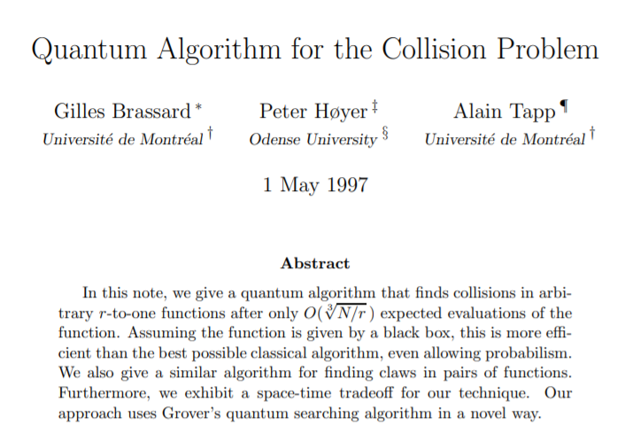

Slide 4






The Collision Problem

Slide 5
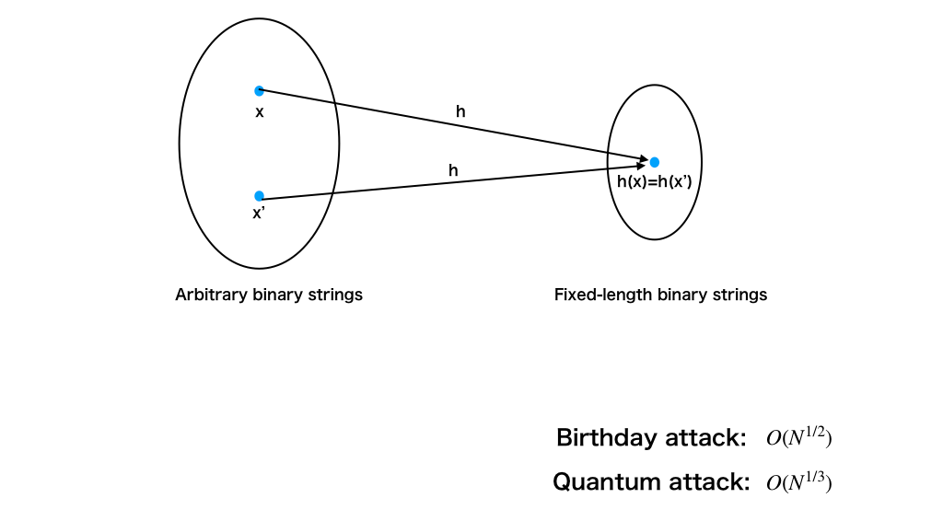
Finding Collision of Hash Function

Slide 6













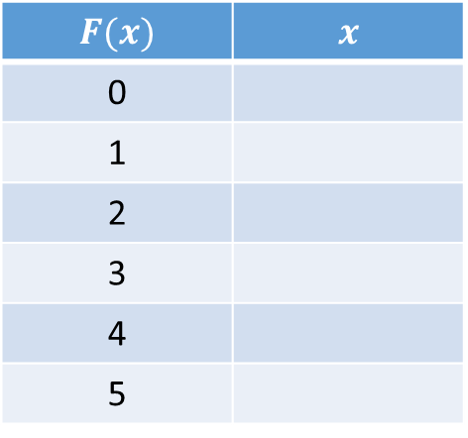


BHT Algorithm: Collision(F, k=|K|)
$$X$$
$$F(x)$$ | $$x$$
0
1
2
3
4
5
$$x_{4}$$
$$x_{2}$$
$$x_{0}$$
$$x_{3}, x_{5}$$
$$K$$
$$x_{3}, x_{5}$$
$$F(x)$$
$$x_{1}$$
$$x_{0}$$
$$x_{1}$$
$$x_{3}$$
$$x_{4}$$
$$x_{2}$$
．．．
$$x_{5}$$
B. Gilles, H. Peter & T. Alain (1997). “Quantum Algorithm for the Collision Problem”.
arXiv:quant-ph/9705002. doi:10.1007/BFb0054319.
Notes:
There is input group X,

Slide 7




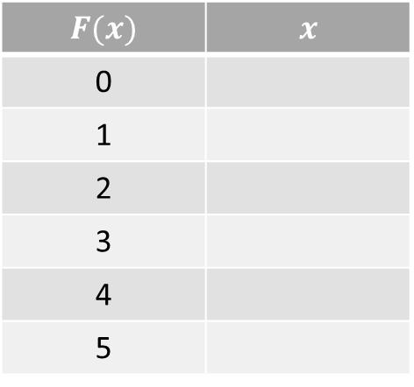

BHT Algorithm: Collision(F, k=|K|)
$$X$$
$$F(x)$$ | $$x$$
0
1
2
3
4
5
$$x_{4}$$
$$, x_{i}$$
$$x_{2}$$
$$x_{0}$$
$$K$$
$$x_{3}$$
$$x_{1}$$
$$x_{0}$$
$$x_{1}$$
$$x_{5}$$
$$x_{3}$$
$$x_{i}$$
$$x_{4}$$
．．．
No collision :(
$$x_{2}$$
$$x_{5}$$
Applying Grover search to find $x_{i}$
B. Gilles, H. Peter & T. Alain (1997). “Quantum Algorithm for the Collision Problem”.
arXiv:quant-ph/9705002. doi:10.1007/BFb0054319.
Notes:
$x_{i}∈𝒳−𝒦$ such that $F\left(x_{i}\right)=F(x_{j})$ for some $x_{j}$ $∈𝒦$

Slide 8
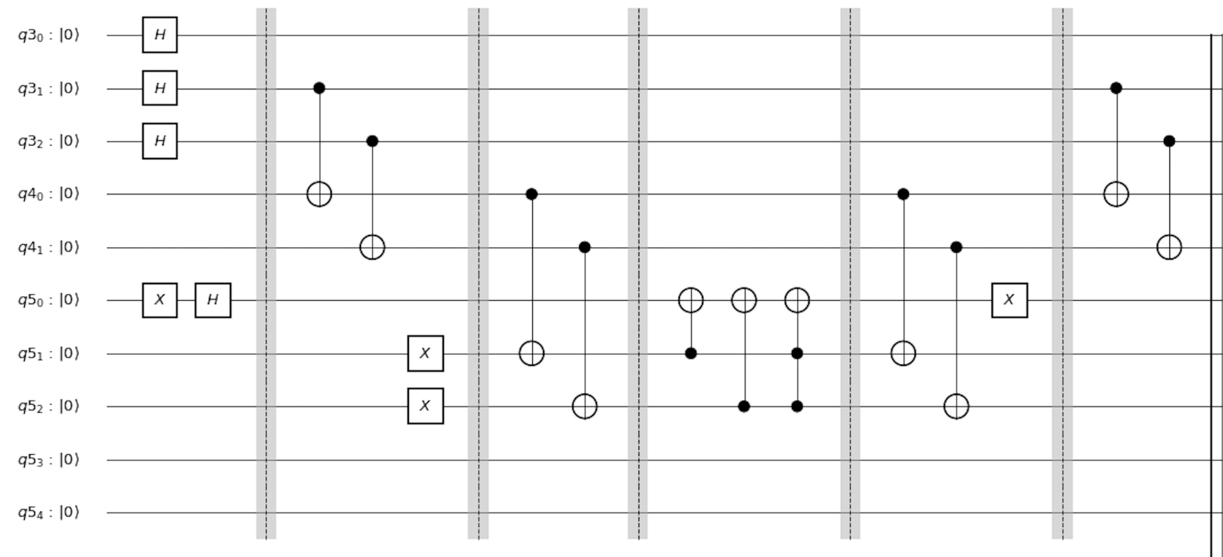
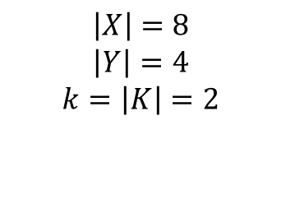
The Implementation on Qiskit
$$X$$
$$K$$
$$\left|X\right|=8$$
$$\left|Y\right|=4$$
$$k=\left|K\right|=2$$
Notes:
Add circuit and page

Slide 9
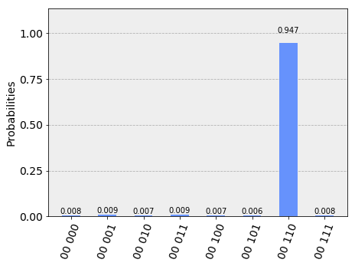
The Implementation on Qiskit
qasm_simulator

Slide 10
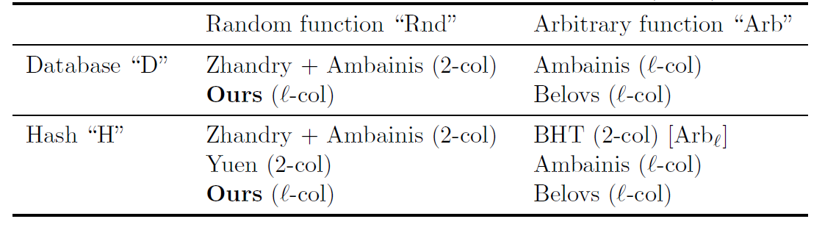
Improvements

